Slide 1
AMP®-Parkinson's Disease Progression Prediction Predicting Parkinson's disease progression using protein and peptide data measurements
Suneela Paluru and Devarasan Sailla

Slide 2
Introduction
Parkinson's disease is a neurodegenerative disorder characterized by tremors, stiffness, balance problems, and slowed movements.
The Movement Disorder Society Unified Parkinson's Disease Rating Scale (MDS-UPDRS) is a widely used assessment tool that captures motor and non-motor symptoms.
Accurate predictions of disease progression can help tailor treatment plans, monitor disease progression, and potentially improve patients' quality of life.

Slide 3
Data Overview
train_peptides.csv: Mass spectrometry data at the peptide level.
Columns: visit_id, visit_month, patient_id, UniProt, Peptide, PeptideAbundance
train_proteins.csv: Protein expression frequencies aggregated from peptide level data.
Columns: visit_id, visit_month, patient_id, UniProt, NPX
train_clinical_data.csv: Clinical data, including UPDRS scores.
Columns: visit_id, visit_month, patient_id, updrs_1, updrs_2, updrs_3, updrs_4, upd23b_clinical_state_on_medication

Slide 4
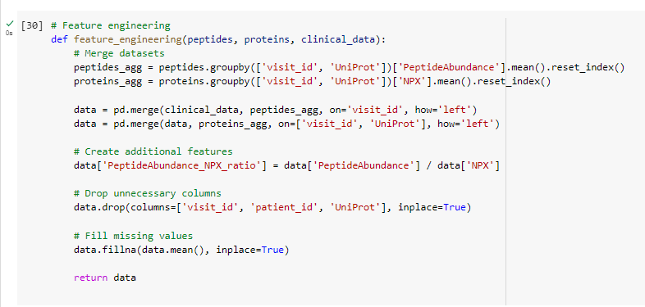
Feature Engineering
We merged datasets by visit_id and UniProt, resulting in a dataframe with columns: visit_id, patient_id, peptide_seq, peptide_abundance, UniProt, NPX, updrs_1, updrs_2, updrs_3, updrs_4
We dropped unnecessary columns (visit_id, patient_id, UniProt), retaining: peptide_seq, peptide_abundance, NPX, PeptideAbundance_NPX_ratio, updrs_1, updrs_2, updrs_3, updrs_4
We filled missing values using the mean of each column.

Slide 5
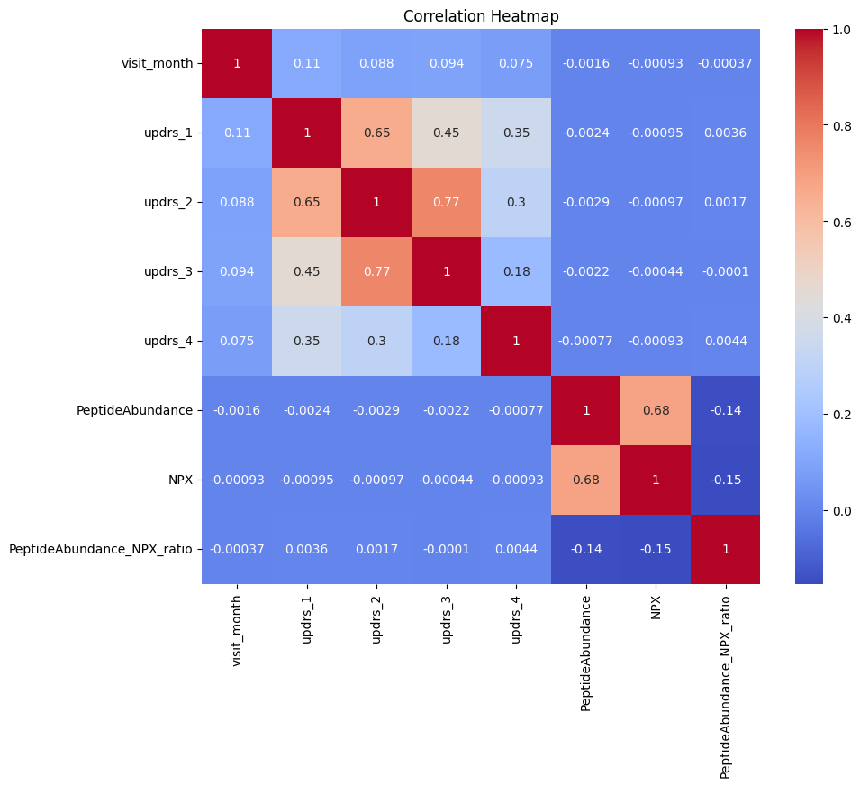
Data Visualization - Correlation Heatmap
The heatmap shows high correlation between NPX and peptide_abundance , indicating potential multicollinearity issues in model training.
Consider removing one of the correlated features or using dimensionality reduction techniques.

Slide 6
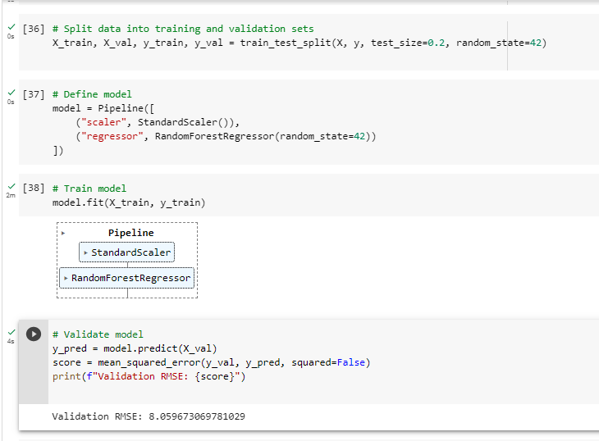
Model Selection and Training
RandomForestRegressor chosen for its ability to handle complex relationships and feature interactions.
Pipeline used to streamline preprocessing with StandardScaler and model training.
Trained the model on the processed dataset (X_train, y_train).

Slide 7
Model Validation
Data split into 80% training and 20% validation sets.
MSE used as the evaluation metric to quantify prediction accuracy.
Validation RMSE: 8.059673069781029, indicating the model's performance.

Slide 8
Conclusion
In this competition, we employed a comprehensive approach for predicting Parkinson's disease progression, encompassing feature engineering, data visualization, model selection, and validation.
Accurate predictions of disease progression have profound implications on both research and patient care, enabling tailored treatments and better management of the condition.
Future improvements and research directions include experimenting with alternative models, refining feature selection, and exploring innovative methods for data augmentation.
In this competition, we employed a comprehensive approach for predicting Parkinson's disease progression, encompassing feature engineering, data visualization, model selection, and validation.
Accurate predictions of disease progression have profound implications on both research and patient care, enabling tailored treatments and better management of the condition.
Future improvements and research directions include experimenting with alternative models, refining feature selection, and exploring innovative methods for data augmentation.

